Slide 1
Programming with Persistent Data Lecture 1: Introduction, what is a file, type of files
Dr. Pierpaolo Dondio,

Slide 2
Lecturer & Timetable
Dr. Pierpaolo Dondio
Office: K115a
Email: pierpaolodondio@dit.ie
Class: Tuesday 9-10, room KE-4-008
Labs: Tuesday 12-13, labs KA-3-008
Tutorials: Thursday 12-13, KE-2-008
Classes are important!
Labs are important too!

Slide 3
Learning Outcomes
Module Aims
Teach the fundamentals of data storage methods and file formats
Teach the procedural programming techniques to implement various storage methods and formats.
Learning Outcomes
Distinguish between various data storage methods and formats
Choose the most appropriate data storage method for a specified requirement
Design and write procedural programs to store and retrieve data in an efficient manner

Slide 4
Content in a nutshell
File Structure: bytes, fields, records, attributes, rows, columns.
File Types: ASCII, Binary, Relational
File Access: Serial, Sequential, Random, Indexed, Index Sequential.
Data Manipulation: Creating persistent data, Retrieving persistent data, Updating persistent data, Deleting persistent data.
File Design: Efficient design of file structure and content.
Common File Techniques: Multiple-file matching, sorting, merging, filtering.
File Security: Reading and writing file permissions.
Programming with Common File Formats (html, xml)

Slide 5
Assessment Methods
Assignment – 30%
Tutorials – 1 written quiz
Labs participation
Assignment
Written exam – 70%
Theory and written exercises

Slide 6
How it works
Lectures notes will go into web courses.
The lecture notes are a guideline that I use to structure the lecture.They are not intended to contain all contents of the course
Lab exercises will be in web courses for the start of each lab (starting week 2)
Attendance please! Good for you, for me, and for the exam!

Slide 7
Book and Resources
“Programming in C” by Paul Kelly
“C – How to program” by Deitel & Deitel (Pearson)

Slide 8
What is a file
Definition
A collection of records involving a set of entities with certain aspects in common and organized for some particular purpose Tremblay and Sorenson [1984]
A collection of similar records kept on secondary computer storage devices Wiederhold [1983]
Organised?
Data in a file does not somehow organize itself.
The decisions related to structuring a file are among the most critical decisions made by the designer of a file system.

Slide 9
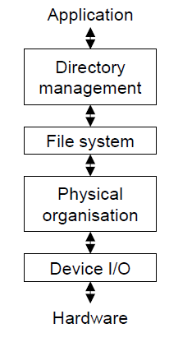
Where files are
Abstract layer approach
Application works with names
In order to translate names into hardware location and instructions, many steps are needed

Slide 10
What’s in a file: Information
bit – 0 or 1
byte: 8 bits
It can store 2^8 = 256 different symbols (number)
Kilo, Mega,Giga,Tera…
2^10 = 1024
2^20 bit more than 1 million
2^30 bit more than 1 billion
2^40 bit more than 1 trillion

Slide 11
Size of Variable (Ansi C)
Data Type | Size in Byte
Char | 1 | One char
byte | 1 | Integer up to 256
int | 2 | Integer up to 65K
Long | 4 | Integer up to 4 billion
Double | 4 | Decimal numbers
String of n characters | n+1 | One is the termination byte
struct | Sum of each variable | A struct is a record, a collection of data types describing an object
How big is the class roster (name, surname) ?
Usually, colours are represented in RGB as a triple of numbers (r,g,b) each of them with 256 possible values. How big is an (uncompressed) picture of resolution 1024 X 786 ?
sizeof function!

Slide 12
Example of Struct
struct database {
int id_number;
int age; float salary; };
int main() {
database employee;
//There is now an employee variable that has
// modifiable variables inside it.
employee.age = 22;
employee.id_number = 1;
employee.salary = 12000.21; }

Slide 13
Text and Binary files
In C, two types of files
Text File
Information (bits) are always interpreted as text
Binary Files
Information are interpreted as custom data (numbers, records, arrays….)
Sequence of records (struct variables !)
On a disk they are the same!
The difference is when data are read and interpreted!
Abc abc /n
def gtf /n
……
Database1 | Database2 | Database3 | Database4 | Database5 | Database6

Slide 14
Text File in C
A file is a pointer to a data type file
FILE *fp;
fopen allows you to open a text file
fp = fopen("write.txt","w");
In order to open a file:
Specify the name (“write.txt” in the example)
Specify the opening mode (“w” in the example)
If the file cannot be open, fp is NULL

Slide 15
Text File, opening modes
r : open for reading
w : Truncate to zero length or create file for writing
a : open or create file for writing at end-of-file
r+ : open for reading and writing, start at beginning
w+ - open for reading and writing (overwrite file) a+ - open for reading and writing (append if file exists)
In order to close a file:
fclose(fp);

Slide 16
Reading characters with fgetc
fgetc(char)
fgetc() is a character oriented function.
The function returns the next character in the file as an unsigned char converted to an int. It will stop reading at the end of file or if a read error occurs.
reading a file byte-by-byte from disk is rather inefficient.

Slide 17
Example – fgetc() Read a file character by character
#include <stdio.h> #include <stdlib.h> int main() { FILE *fp; //declaring a file variable char ch; fp = fopen("myfile.txt","r") // opening the file if (fp == NULL) { //check for error printf("Cannot open file.\n"); exit(1); } while((ch = fgetc( fp )) != EOF) { //while not end of file printf("%c", ch); //display on scree } fclose(fp); //close file return 0; }

Slide 18
Reading strings (=arrays of char)
fgets(string,size,file)
The function reads from the file and places the output into the character array pointed to by s. It will stop reading when any of the following conditions are true:
It has read n - 1 bytes (one character is reserved for the null-terminator), or
It encounters a newline character (a line-feed in the compilers tested here), or
It reaches the end of file, or
A read error occurs.
fgets() appends a null-terminator to the data read.

Slide 19
Example – fgets() – Reading a file line by line
#include <stdio.h>
#include <stdlib.h>
int main(int argc, char *argv[])
{
FILE *fp;
const int LINE_MAX = 50; //maximum size of a string
char line[LINE_MAX]; //string of size LINE_MAX-1
fp = fopen("myfile.txt","r"); //open file
if (fp ==NULL) { //check for errors
printf("Cannot open file.\n");
exit(1);
}
while(fgets( line, LINE_MAX, fp ) != NULL) { //see next slide
printf("%s", line);} //print on scree
fclose(fp); //close file
return 0;}

Slide 20
fgets() – extra explanations
while(fgets( line, LINE_MAX, fp ) != NULL) {
printf("%s", line);} //print on screen
Note the termination condition. We now check if the results of fgets is NULL (with fgetc we check the EOF condition)
At any iteration we read LINE_MAX characters.
If the line is shorter than LINE_MAX characters, we only read to the end of the line
If the line is longer than LINE_MAX characters, we read only part of the line (up to LINE_MAX characters). So chose the correct value of LINE_MAX, it must be bigger than the bigger line in your text!

Slide 21
Reading fields – fscanf()
fscanf(FILE, formatted_string, variable_list)
Example:
while (fscanf(fp, "%s" "%i", student , &mark) != EOF) {…..}
You must know the exact data layout of the input file in advance and rewrite the function call for every different layout.
It's difficult to read text strings that contain spaces because fscanf() sees space characters as field delimiters

Slide 22
fscanf() extra explanation

Slide 23
Write to a text file
fputc(char ch, FILE *fp)
fputs(string ch, FILE *fp) //string is an array of char, therefore *char
fprintf(*FILE, format_string, variables)
fprintf(ofp, "%s %d\n", username, score+10);

Slide 24
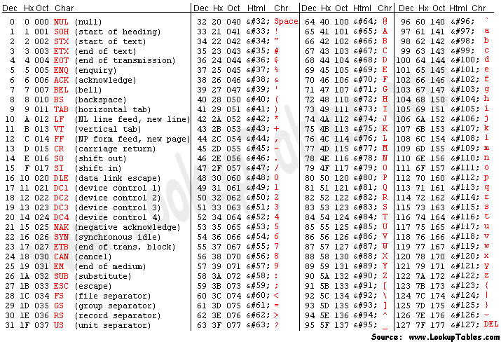
Some operation with chars

Slide 25
Binary Files
Streams of bytes
Structure is given by the application
Open – add the letter b to the opening mode
Close – the same

Slide 26
Reading a Binary file
fread(variable, size_of_one_element, number_of_elements, FILE);
Example:
FILE* file = fopen(FILENAME, "rb");
char buf[8];
double num[8]
fread(buf, 1, 8, file); // Read first 8 bytes
fread(buf, 1, 8, file); // Read next 8 bytes
fread(num, sizeof(double), 8, file); //read 8 integer of data (16 bytes)

Slide 27
Positioning in a file
fseek() can move the file pointer at any location.
Returns 0 if operation was correct
int fseek(FILE, offset in byte, whence);
whence is:
SEEK_SET - Set position equal to offset. It is a default value and when whence is not specified, it automatically as SEEK_SET
SEEK_CUR - Set position to current location plus offset
SEEK_END - Set position to EOF plus offset (to move to a position before EOF, the offset must be a negative value)
Examples:
fseek(file,10,SEEK_CUR)
fseek(file,10*sizeof(double),SEEK_CUR)

Slide 28
Writing a Binary File
fread(void *ptr, size_t size_of_elements, size_t number_of_elements, FILE *a_file);
size_t fwrite(const void *ptr, size_t size_of_elements, size_t number_of_elements, FILE *a_file);

